Slide 1
Indian Marriage Analysis
By Prasanjit Rout

Slide 2
Project Overview
This project includes a comprehensive case study on the Indian Marriage Industry, focusing on market trends, cultural aspects, and business opportunities. As part of the analysis, I worked with a 10,000-entry dataset, solving complex SQL queries to extract meaningful insights.
Additionally, I developed a Tableau Dashboard that highlights key societal trends, including marriage types, parental approval, dowry cases, and divorce rates. The project is documented in an IEEE-style report, ensuring a structured and professional approach to research and data-driven storytelling.

Slide 3
COntents
Dataset
Comprehensive Indian Marriage Industry Analysis
Data Extraction and Analysis using SQL
Tableau Dashboard

Slide 4
DATAset
Source: Kaggle
Columns Available : 18
ID, Marriage_Type , Age_at_Marriage, Gender
Education_Level, Caste_Match, Religion, Parental_Approval
Urban_Rural,Dowry_Exchanged ,Marital_Satisfaction ,Divorce_Status
Children_Count, Income_Level, Years_Since_Marriage
Spouse_Working , Inter-Caste, Inter-Religion

Slide 5
Comprehensive Indian Marriage Case Study
The IEEE-format research paper on Indian Marriage Analysis presents a structured study on marriage trends in India. It includes a literature review, data methodology, and statistical analysis..
The paper follows IEEE formatting with abstract, introduction, methodology, results, discussion, and conclusion, providing data-driven societal insights.

Slide 6
SQL data extraction and analysis
In this document I have worked upon the Data Extraction and Analysis addressing
the queries through SQL .
Retrieve all records where Marriage_Type is "Love".
Count the number of marriages where Parental_Approval is "Yes".
Find the average Age_at_Marriage for males and females separately.
Get the number of people with a Graduate education level.
Find the count of marriages where Dowry_Exchanged is "Yes".
List the top 5 most common Education_Level values and their frequencies.
Calculate the percentage of inter-caste marriages (Inter-Caste = "Yes") in the dataset.
Find the highest, lowest, and average Years_Since_Marriage.
Identify the most common income level among those who got divorced.
Count the number of urban and rural marriages separately.

Slide 7
Problem Statements:
Find the correlation between Parental_Approval and Divorce_Status (how many divorces occur in approved vs. non-approved marriages).
Determine the percentage of marriages where Spouse_Working is "Yes" and Marital_Satisfaction is "High".
Find the average number of children_Count for arranged vs. love marriages.
Count how many inter-religion marriages (Inter-Religion = "Yes") also have Inter-Caste = "Yes".
Find the percentage of individuals with a Postgraduate degree who had an arranged marriage.
Find the most common education among couples with High marital satisfaction.
Analyze whether Years_Since_Marriage correlates with Marital_Satisfaction.
Calculate the average Children_Count for different Marital_Satisfaction levels.
Find the proportion of people with middle income who have experienced divorce.
Identify the most common combination of education and Marriage_Type among urban vs. rural populations.
Determine the average Age_at_Marriage for divorced vs. non-divorced individuals.

Slide 8
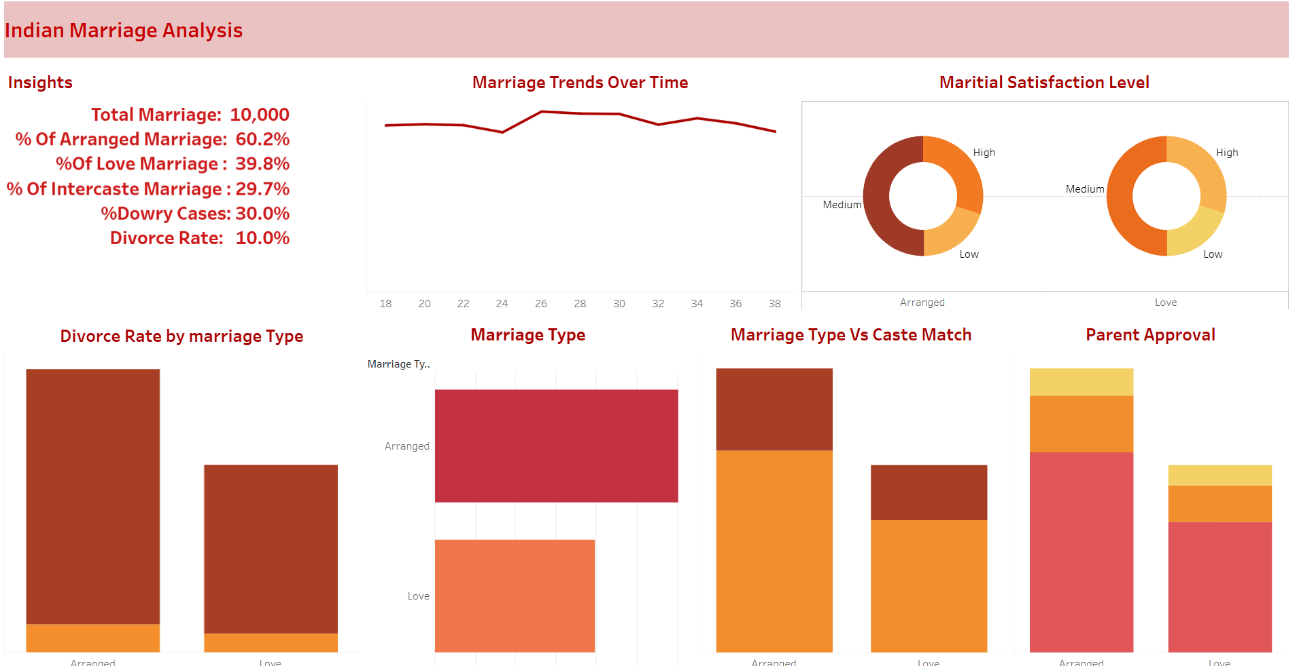
Tableau dashboard

Slide 9
Learning OutComes
Document Preparation: IEEE-format research writing, structured documentation, and analytical storytelling.
Data Extraction & Analysis: SQL querying, data cleaning, and deriving key insights from a 10,000-entry dataset.
Visualization: Tableau dashboard design, KPI representation, and societal trend analysis.
Analytical Thinking: Identifying patterns in marriage trends, dowry cases, and divorce rates.
Problem-Solving: Tackling complex queries and ensuring accurate data interpretation

Slide 10
Thank You

